Slide 1
Indo-Saracenic Architecture
Indian Art Form Project

Slide 2
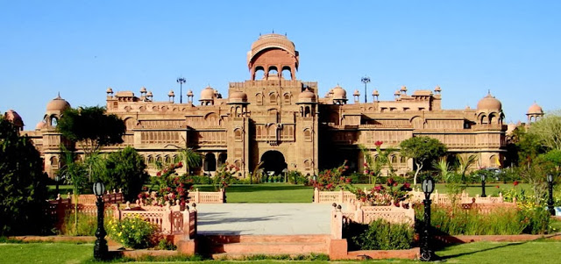
What is indo-saracenic architecture?
Indo-Saracenic architecture (also known as Indo-Gothic, Mughal-Gothic, Neo-Mughal, in the 19th century often Hindoo style) was a revivalist architectural style mostly used by British architects in India in the late 19th century, especially in public and government buildings in the British Raj, and the palaces of rulers of the princely states.
It drew stylistic and decorative elements from native Indo-Islamic architecture, especially Mughal architecture, which the British regarded as the classic Indian style, and, less often, from Hindu temple architecture.
The basic layout and structure of the buildings tended to be close to that used in contemporary buildings in other revivalist styles, such as Gothic revival and Neo-Classical, with specific Indian features and decoration added.

Slide 3
History
Saracenic was a term used by the ancient Romans to refer to a people who lived in desert areas in and around the Roman province of Arabia, and who were distinguished from Arab. Some use this term to refer to Indo-Islamic Architecture. However, it basically refers to the style that diffused from the 1870’s to the early 20th century for colonial buildings in India, adding the elements of Mughal architecture, to the base of Victorian Gothic style.
Initially the British constructed governmental and public buildings in European classical styles regardless of Indian local climate and traditions. Only after the 1858, the local architectural traditions, especially the Mughal tradition were introduced to the colonial erections. This was also the time of Gothic Revival, so Gothic features were used as the base and the domes and Chhatris were used to produce the external appearances to the buildings. This is the reason that it is also known as Indo-British style.
Early examples of Indo-British Style are the New Palace of Kolhapur (1881) designed by Charles Mant and Muir College (1886) in Allahabad designed by William.

Slide 4
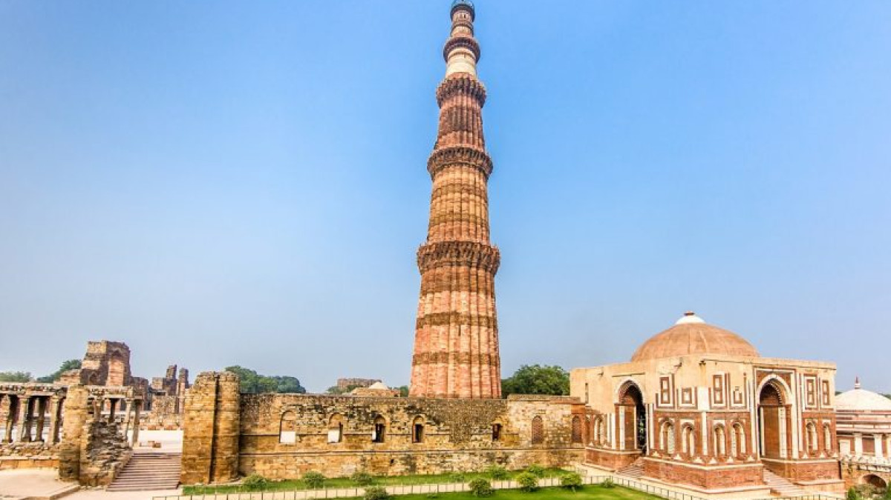
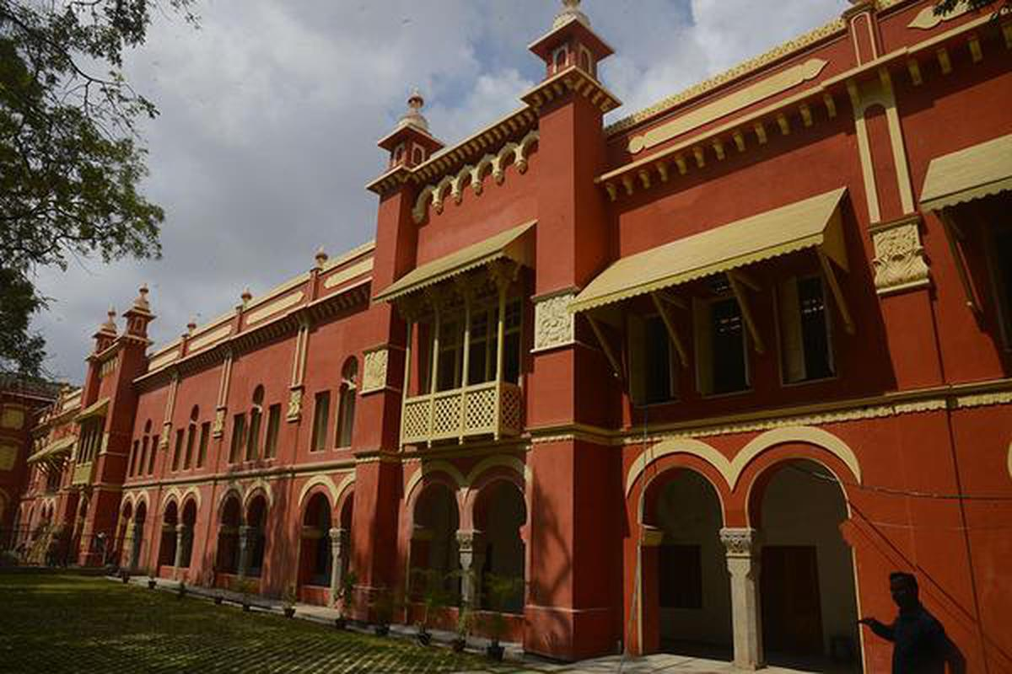
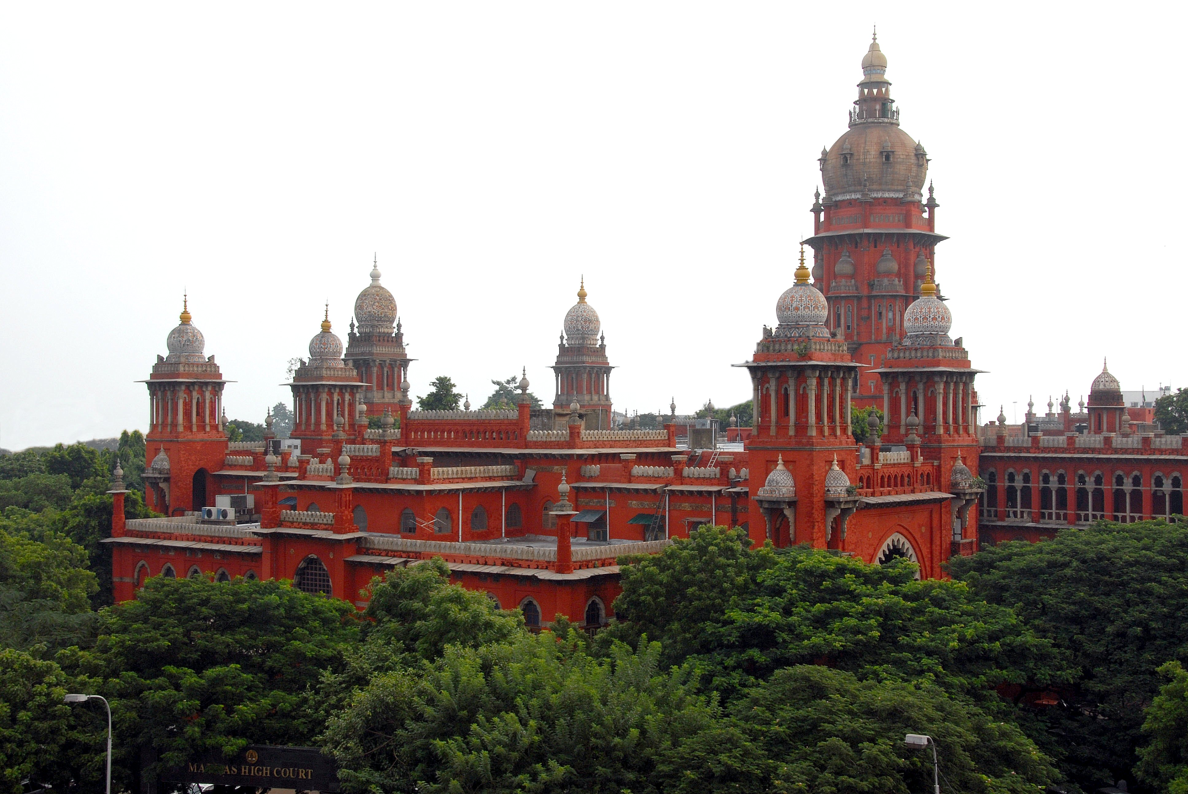
Indo-Saracenic Architecture
Qutub Minar New Delhi
Chepauk Palace Chennai
Madras High Court Chennai

Slide 5
Characteristics
The style has been said, by a native of Kolkata,to be most common in "Southern and Western India", and of the three main cities of the 19th-century Raj, it was and is much more evident in Mumbai and Chennai rather than Kolkata, where both public government buildings.
The mansions of wealthy Indians tended to use versions of European Neoclassical architecture.Madras (now Chennai) was a particular centre of the style, but still tended to use details from Mughal architecture, which had barely ever reached Tamil Nadu before.
This was partly because English authorities such as James Fergusson especially deprecated Dravidian architecture, which also would also have been harder and more expensive to adapt to modern building functions.

Slide 6
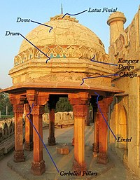
Characteristics
Typical elements found include:
onion (bulbous) domes
Chhajja, overhanging eaves, often supported by conspicuous brackets
pointed arches, cusped arches, or scalloped arches
horseshoe arches, in fact characteristic of Islamic Spain or North Africa, but often used
contrasting colours of voussoirs round an arch, especially red and white; another feature more typical of North Africa and Spain
curved roofs in Bengali styles such as char-chala
domed chhatri kiosks on the roofline
pinnacles
towers or minarets
open pavilions or pavilions with Bangala roofs
jalis or openwork screens
Mashrabiya or jharokha-style screened windows
Iwans, in the form of entrances set back from the facade, under an arch.

Slide 7
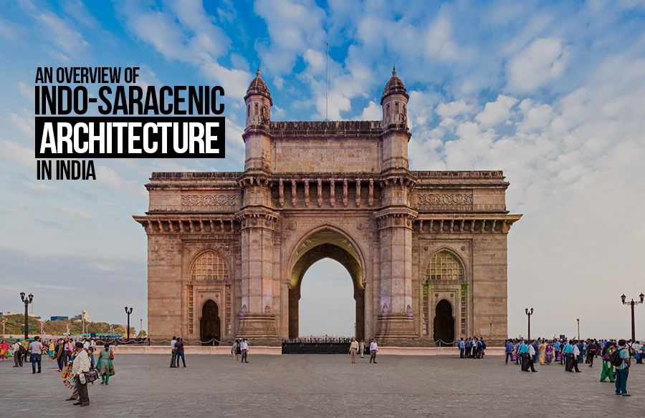
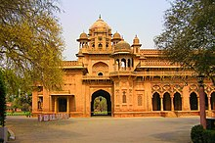
Indian Context
Confluence of different architectural styles had been attempted before during the mainly Turkic, Delhi Sultanate and Mughal periods. Turkic and Mughal incursions in the Indian subcontinent, introduced new concepts in the much more advanced high architecture of India.
The prevailing style of architecture was trabeate, employing pillars, beams and lintels, with less emphasis on arches and domes used during earlier Buddhist periods. T
he Turkic invaders brought in the arcuate style of construction, with more emphasis on arches and beams, which flourished with Mughal and Taluqdars by building and incorporating Indian architecture, especially Rajasthani temple architecture and Imperial Indian palace/fort/urban architecture as well.

Slide 8
The Palladian Style
When the British became a power, there were three styles prevalent in England viz. the Palladian, Baroque and the Victorian. The Palladian style of architecture is based on the works of Andrea Palladio (17th century) of Italy.
Identified with a few features such as the ceilings as an ornamental focus, mouldings often featuring masks, terms and shells or other depictions of nature, fireplaces and wall painting. A great central tower rising from a succession of traced roofs is one important characteristic of this style.
The another important feature is Palladian window, which consists of a central section with semicircular arch over and two sections on either sides, all supported by pillars, as shown in the adjacent image.
This was a feature inculcated in India in some buildings (in Lucknow for example) though as such we don’t find any monument made purely on Palladian style.

Slide 9
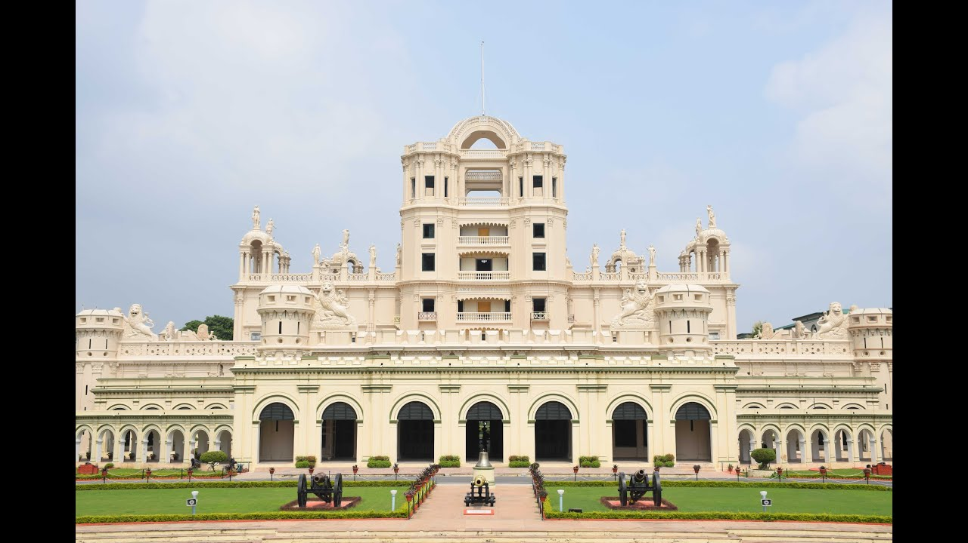
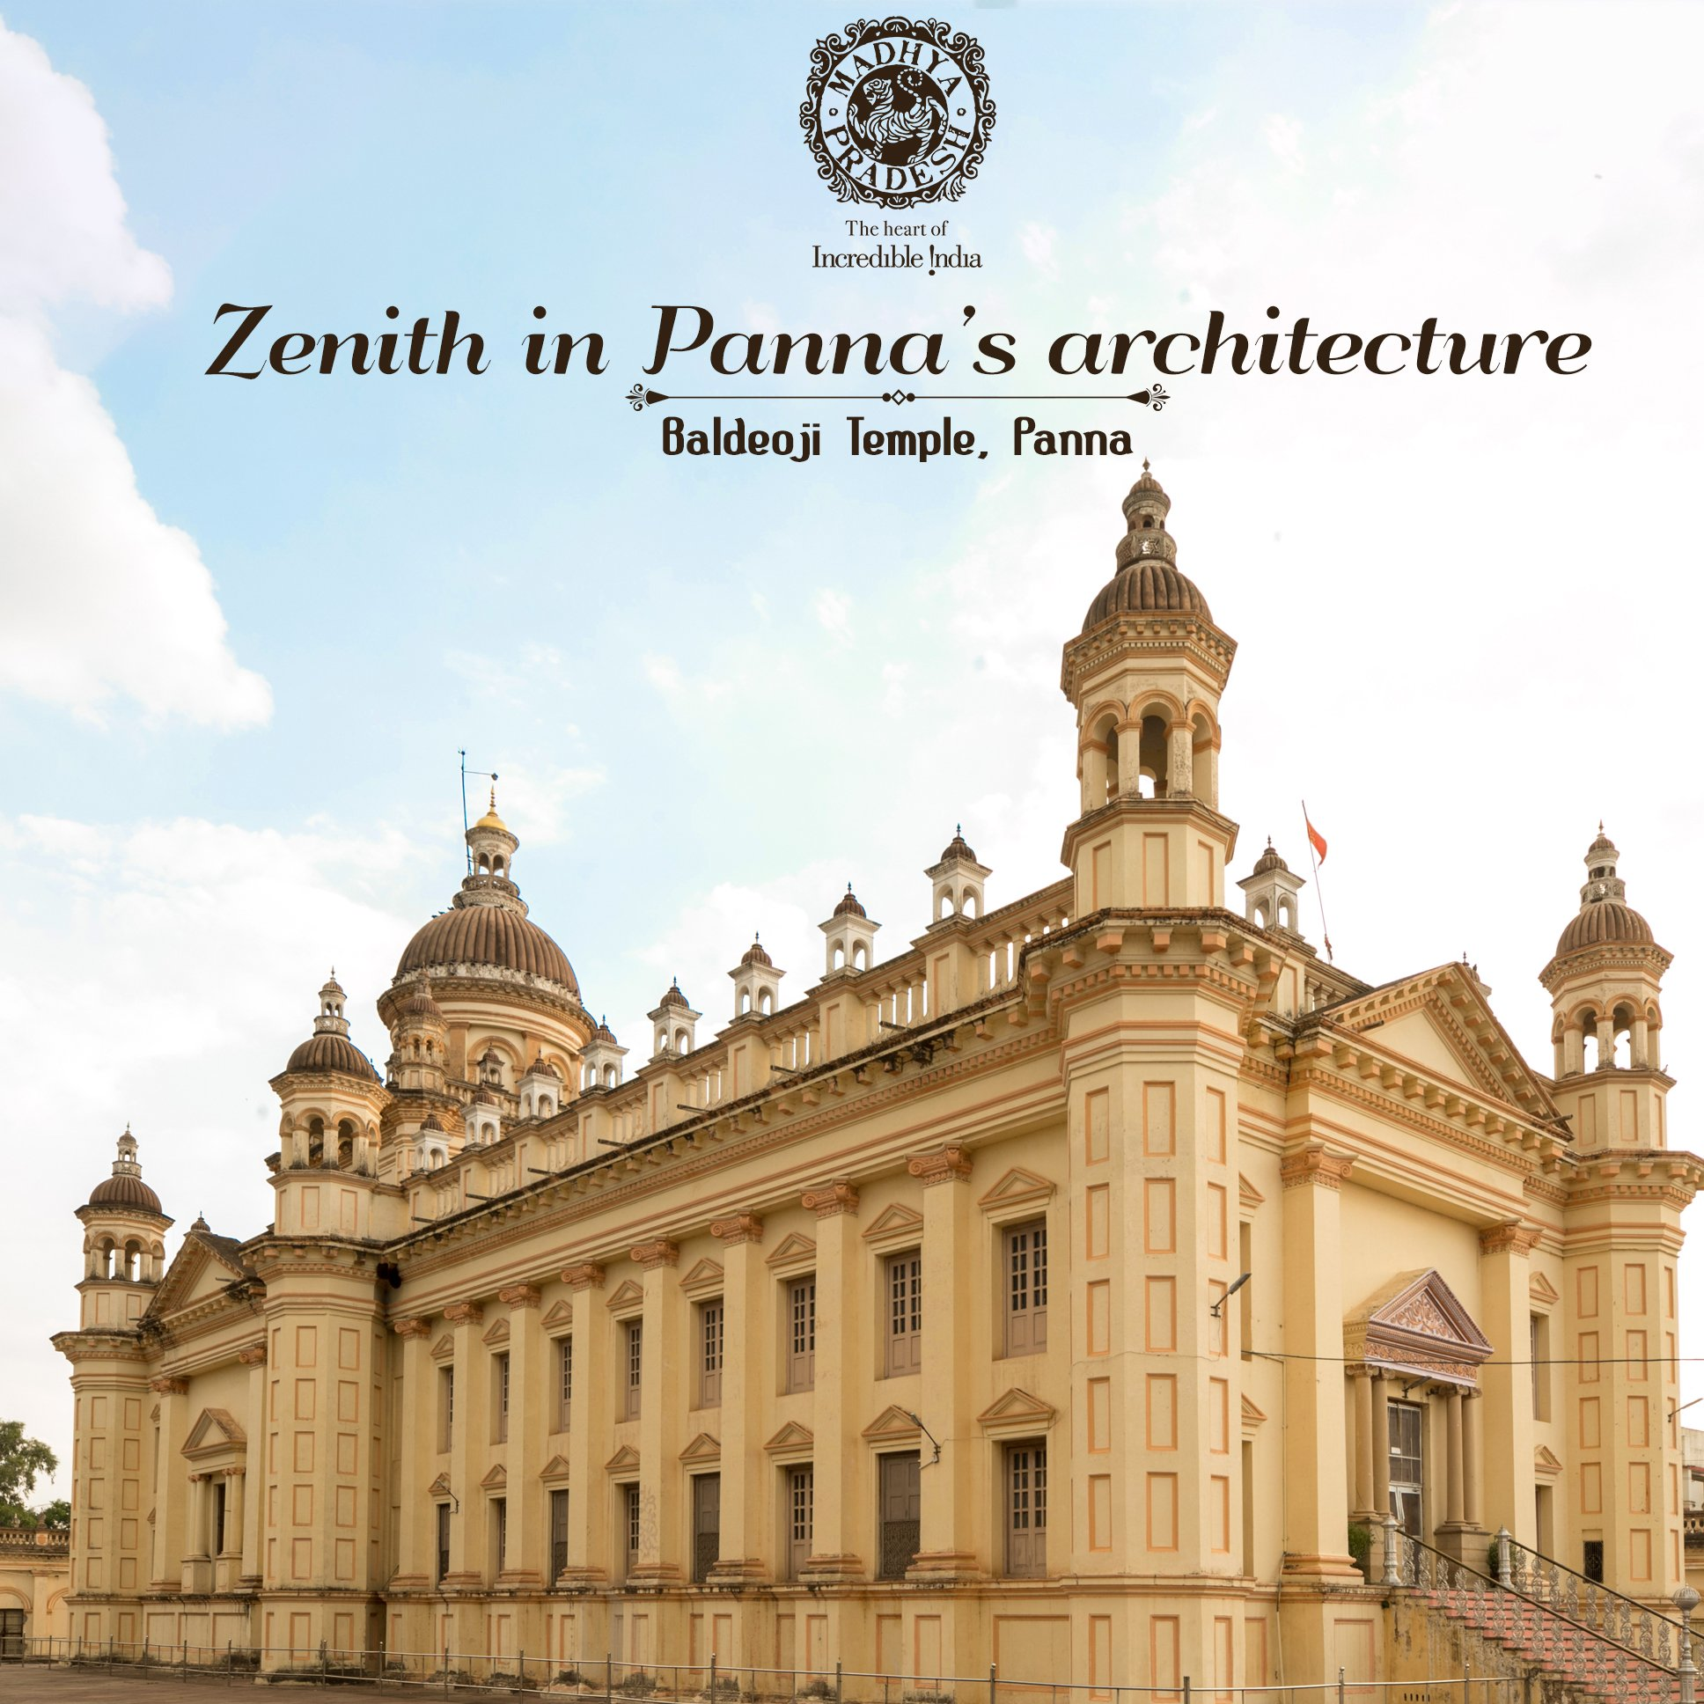
The Palladian Style
la martiniere college Lucknow
Baldeoji Temple Panna

Slide 10
The Victorian Gothic Style
When, India saw the emergence of presidencies of Madras, Bombay and Bengal, the fashion in England was of Gothic revival and neoclassical architecture. At the same time, the Victorian style was also in vogue.
So, in the years to come, the buildings and monuments saw a mix of Indian (Mughal) style, Victorian, Gothic, Palladian, Baroque and other styles. However, none of the styles prevalent in Europe in those times were original. All of them were either imitated features from earlier Romanesque or Georgian architecture. The Victorian Gothic Architecture thus, was basically a hotch-potch of early European styles mixed with the introduction of Middle East and Asian influences.
The Victoria terminus station (Now the Chhatrapati Shivaji Station), in Mumbai, is one of the examples of Victorian gothic revival architecture in India. This monument represents the themes deriving from Indian traditional architecture. This building designed by F.W. Stevens, became the symbol of Bombay as the gothic city.

Slide 11
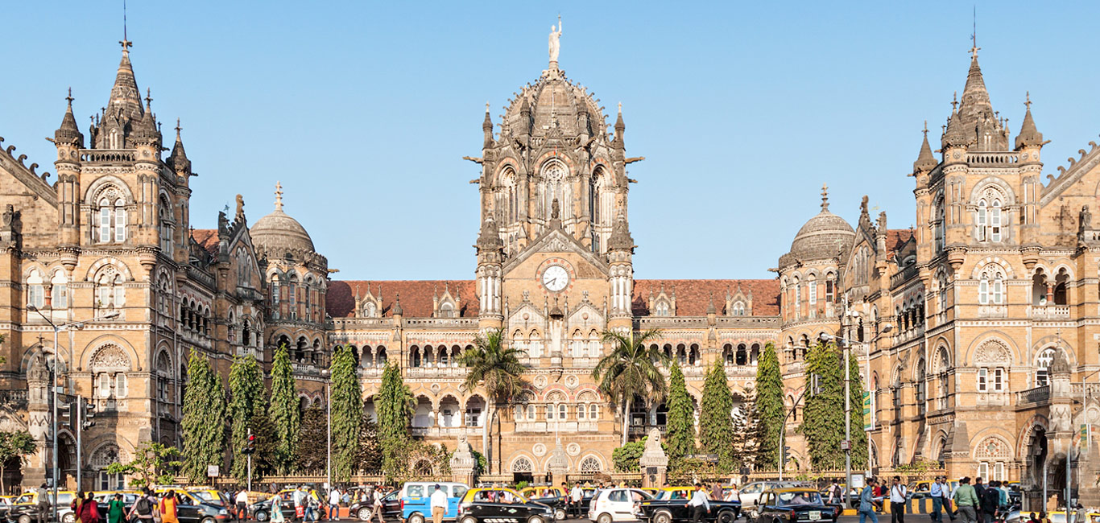
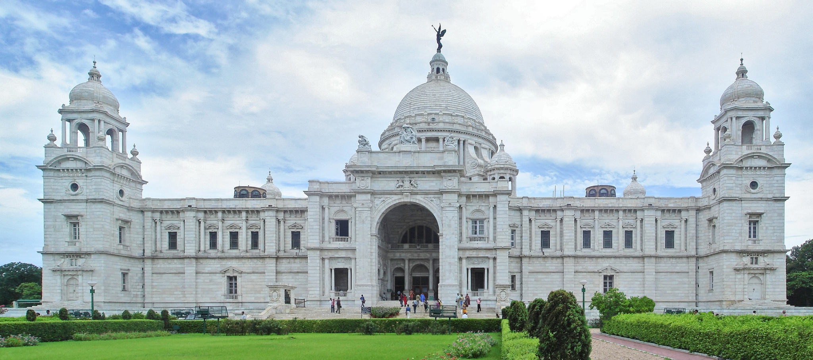
The Victorian Gothic Style
Chhatrapati shivaji terminus Mumbai
Victoria Memorial Kolkata

Slide 12
Architecture in Delhi
In 1911, the capital of British India was shifted to Delhi. From 1912 to 1931 British architects Sir Edwin Landseer Lutyens and Sir Herbert Baker designed the new imperial capital of India.
The objective was to successfully combine the local traditions with a statement of colonial power. These architects studied the Buddhist, Hindu and Islamic features while drawing and redrawing their plans.
The Lutyens Delhi finally emerged with a huge dome with most if the building representing elements of the Hindu or Islamic architecture. The structures such created like the Mughal Gardens brought the majesty of Mughal periods, though the utility of the structures were comprised to a great extent.
The Viceroy’s House (Now Rashtrapati Bhawan) was inspired by the neoclassicism but to a great extent was able to bring back the Mughal architecture in its use of red and yellow sandstone, its dome, and in other details.

Slide 13
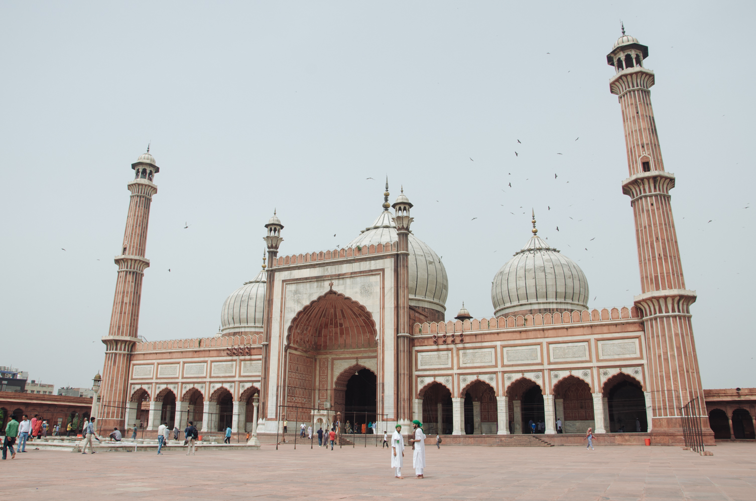
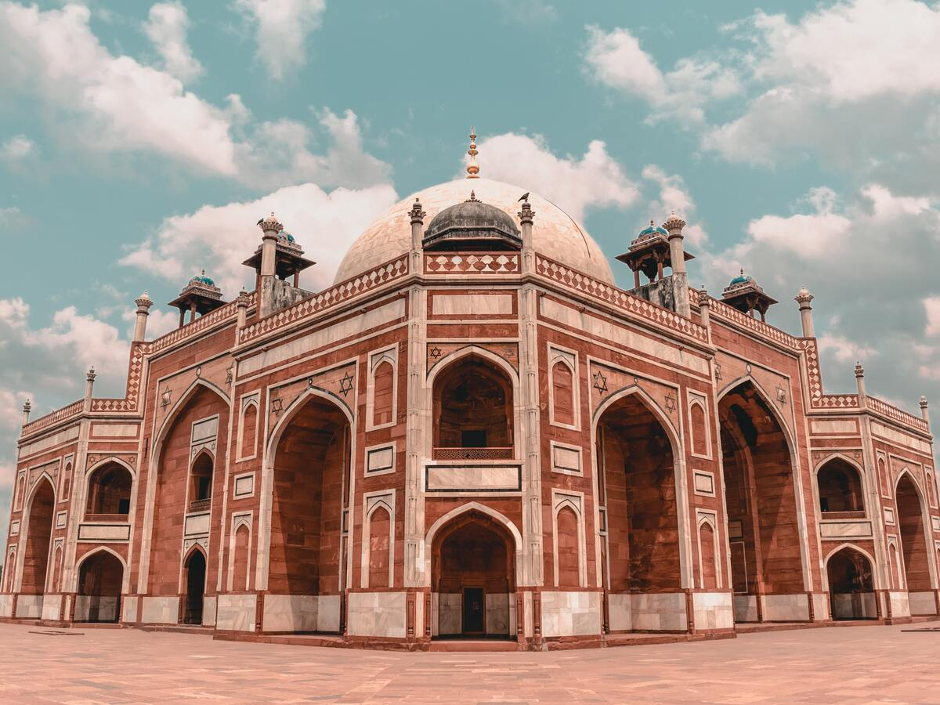
Architecture In Delhi
Jama Masjid Old Delhi
Humayun’s Tomb New Delhi

Slide 14
THANK YOU
MADE BY:-
DIKCHA SINGH (RA2011027010096)
KARAN SHARMA (RA2011027010077)
SIDDHANT SHEKHAR (RA2011027010130)
AVINASH CHOUBEY (RA2011027010111)
DEEPESH SHARMA (RA2011027010104)

